Slide 1


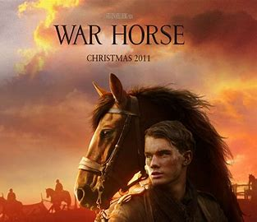

War Horse Film Review
By Student A

Slide 2
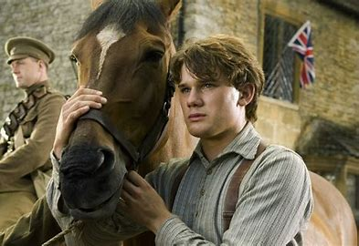
Introduction
War Horse, a film directed by Stephen Spielberg, was released on the 25th of December, 2011 and a screenplay written Lee Hall and Richard Curtis. The cast includes Jeremy Irvine, Emily Watson, David Thewlis and even has appearances from Marvel actors Benedict Cumberbatch and Tom Hiddleston.
This movie is all about the battle between Britain and Germany during World War 1 and how horses were used in battle. It shows the blood and tears of war and the realism of wars.

Slide 3
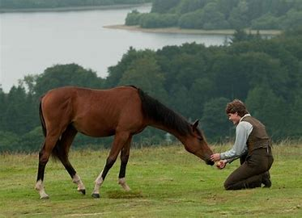
Plot Summary
Albert Narracott is a young man that lives on a farm with his mum Rose and dad Ted. One day Ted gets drunk and buys a small horse that he needed to plough for a lot more than he wanted to spend. Albert develops a connection with the horse (he called him Joey) and gets him to plough. A war then suddenly breaks out between Britain and Germany and they take Joey to go and help the soldiers. Joey then goes on an adventure through Germany and has multiple owners over the years. Then he gets reunited with Albert when the war is over and Albert gets to take him home. Although Albert has been injured from the war and couldn’t see him to start with, he still felt the connection between the two.

Slide 4
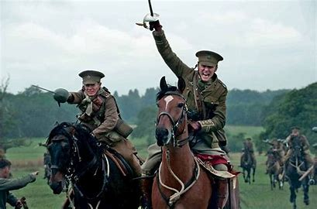
Description
War Horse is a great movie to watch with the family because it has a lot of lessons to be learned, like never giving up and always fight for the things that you love. War Horse has a lot of dark and sad scenes but also has a lot of bright happy scenes. Although the story is mainly about war, Stephen Spielberg manages to put in scenes that made the world seem like butterflies and rainbows. There is lot of music in War Horse that really establishes the scenes, especially when they use music during the fight scenes to create tension and suspense.

Slide 5
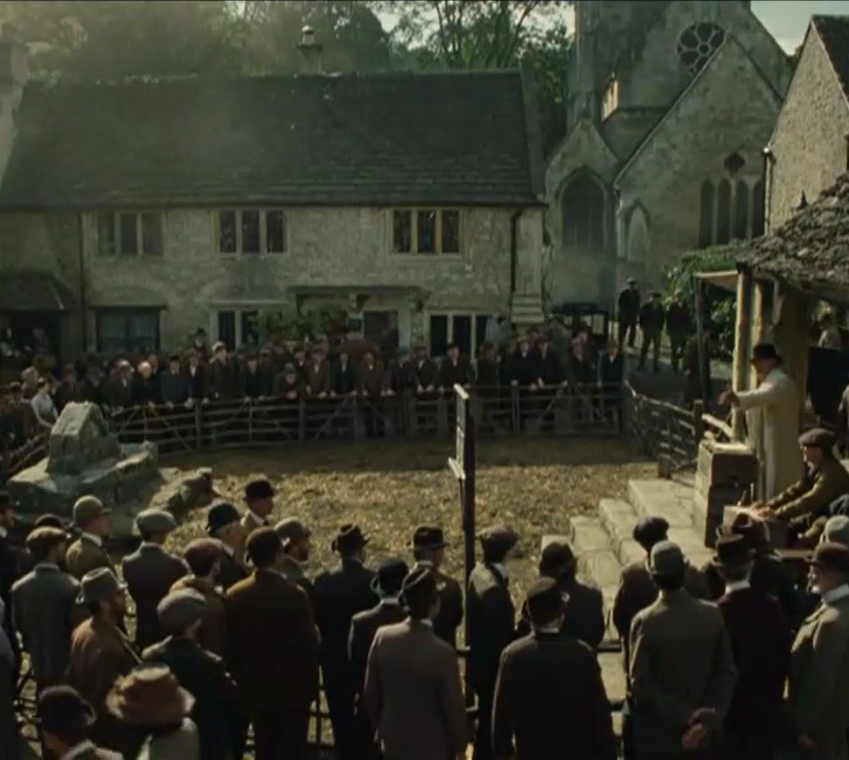
Analysis
The auction scene in War Horse uses very clever mis-en-scene to develop characters such as Ted Narracott and his landlord. Stephen Spielberg gets Ted and the landlord to stand on opposite ends of the auction circle and the extras in between. Stephen cleverly used the circle to represent the social scale of the local town people. He put the poorer people on one side and the richer people on the other side which consisted of the rich landlord and then Ted on the other side. This develops the characters by telling us that the landlord is rich and has money to spend and Ted is no where near as rich. Ted is also drinking and getting drunk in this scene while he bets way too much money on Joey. This says that he is an alcoholic and has no control.

Slide 6
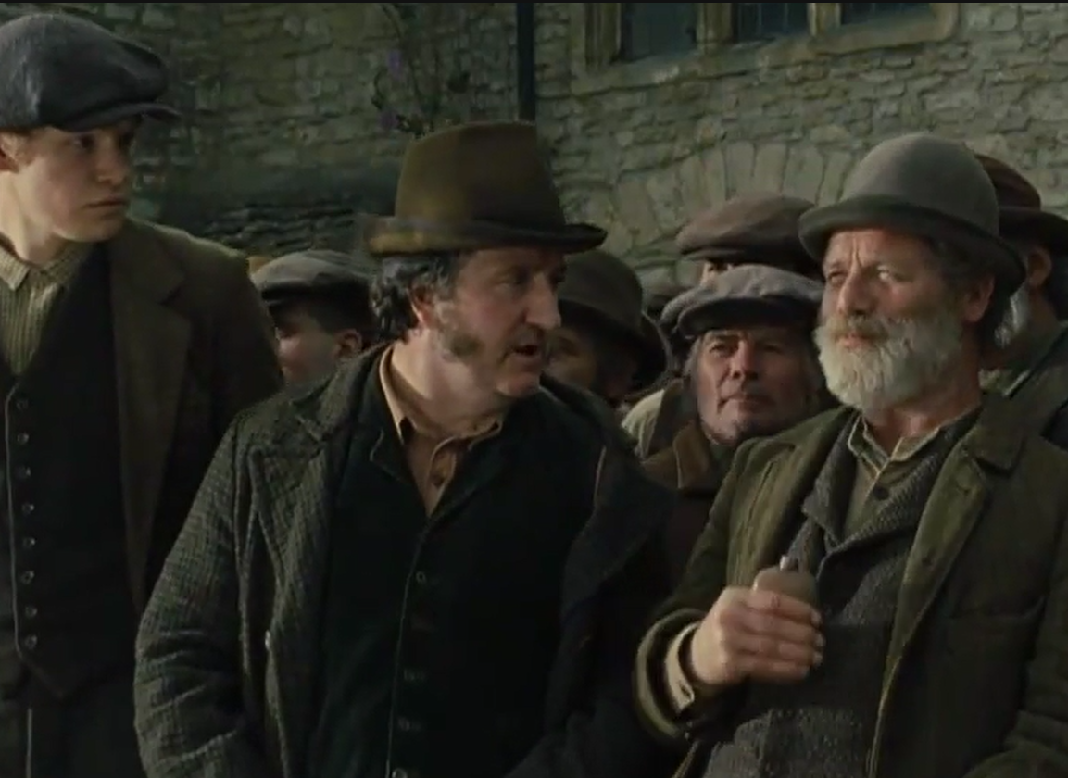
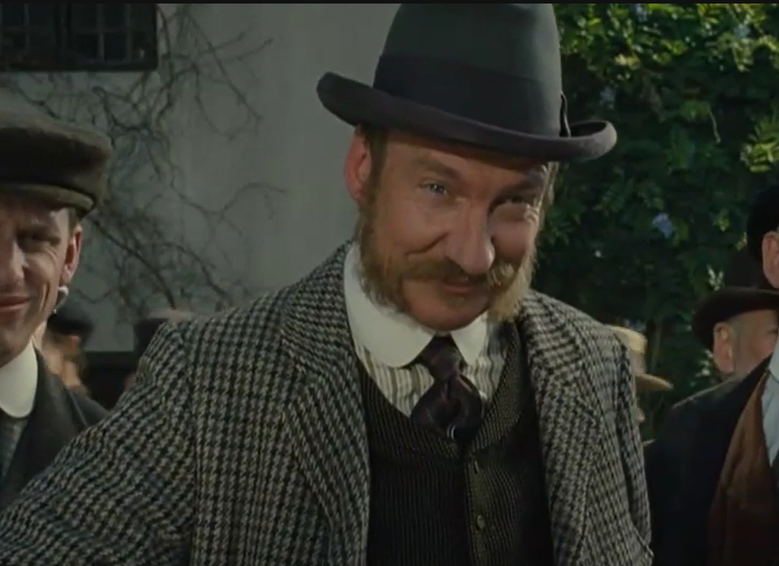
Analysis
In this scene Spielberg also uses acting to develop the characters of Ted Narracott and his landlord. Ted Narracott is drunk and is waving his hands around showing that he is immature and is slightly irresponsible. His landlord is very stern and responsible. He backs off when Ted bets a lot of money on Joes which shows that he is smart and has control over his money. Spielberg also uses camera in this scene to switch between Ted and his landlord to create suspense and intensity. The more money they bet the closer the camera gets to them which means the whole auction on Joey is basically just them two competing. It shows the rivalry that the two have between them and it makes them go way harder than they have to which resulted in Ted spending way too much money on Joey. With Ted buying Joey it has a cause and effect of Albert falling in love with Joey and it creates a storyline.

Slide 7
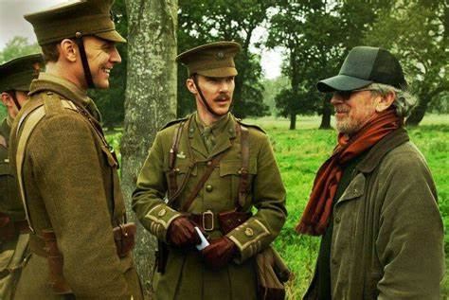
Conclusion
I recommend War Horse to anyone because it has action, true events and a great storyline of a boy that loved a horse. It will make you laugh and it will make you cry which is exactly what you want out of a movie. You will fall in love with Joey and will see how much of an impact a horse can have on someone's life. Not only does it have Tom Hiddleston but it also has Benedict Cumberbatch. Two amazing marvel actors that have been a huge inspiration throughout the years come together to create n amazing war story. Stephen Spielberg is an amazing director and has made an incredible film worth watching and so I give War Horse 5 stars out of 5.

